Slide 1
Tensorflow :
Large-Scale Machine Learning on Heterogeneous Distributed Systems
Mohammad Amin Samadi

Slide 2
Outline
Abstract
Programming Model and Basic Concepts
Implementation
Extensions
Optimizations
Common Programming Idioms
Tensorboard

Slide 3
Abstract
TensorFlow is both an interface for expressing machine learning algorithms and an implementation to execute them
Code can be transported across various machine architectures with little to no changes to the code
Has been used at Google for all manner of machine learning tasks

Slide 4
Outline
Abstract
Programming Model and Basic Concepts
Implementation
Extensions
Optimizations
Common Programming Idioms

Slide 5
2. Programming Model and Basic Concepts
TensorFlow computations are represented by directed graphs, which are composed of nodes
Values of ‘normal’ edges , connecting one node’s output to another node’s input , are tensors , n-dimensional arrays.
There are special edges called control dependencies : no model data is transferred on these edges, rather they indicate that the source node must finish execution before the destination node begins execution.

Slide 6
(cont) Programming Model
Operations and Kernels
Operations have names and represent an abstract computation, such as "matrix multiply" or "add"
Sessions
Clients interact with TensorFlow by creating a Session, which supports two main functions: Extend and Run
The Extend method adds additional nodes and edges to the existing dataflow model
Variables
A Variable is a handle to a persistent and mutable tensor which survives each execution of a graph
For ML tasks, learned parameters are usually held in TensorFlow Variables

Slide 7
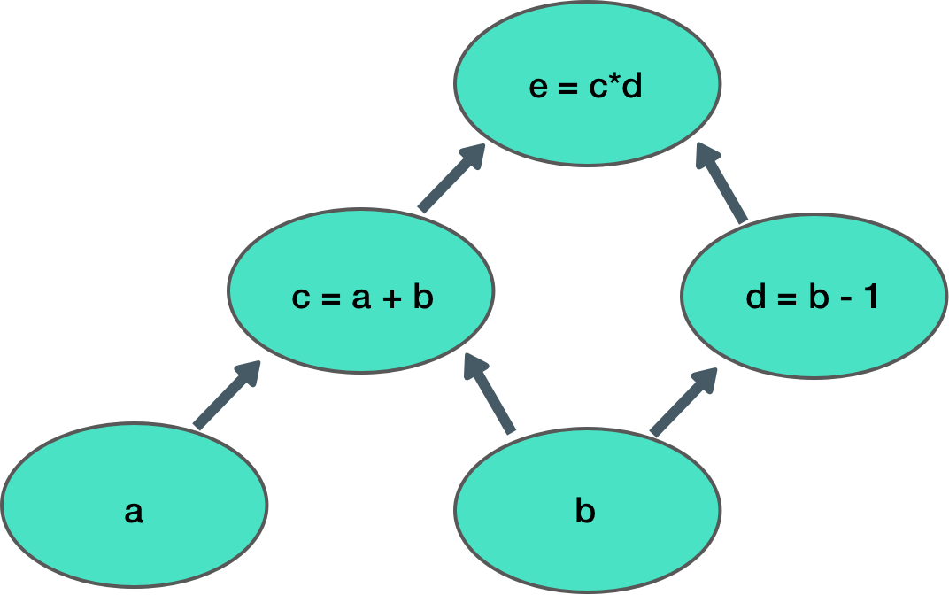
Computational Graph
import tensorflow as tf
a = tf.Variable(initial_value=10)
b = tf.Variable(initial_value=5)
c = tf.add(a , b)
d = tf.subtract(b , 1)
e = tf.multiply(c , d)
with tf.Session() as s:
i = tf.global_variables_initializer()
s.run(i)
res = s.run(e)
print(res)
>> res = 60

Slide 8
Outline
Abstract
Programming Model and Basic Concepts
Implementation
Single-Device Execution
Multi-Device Execution
Node Placement
Cross-Device Communication
Distributed Execution
Extensions
Optimizations
Common Programming Idioms

Slide 9
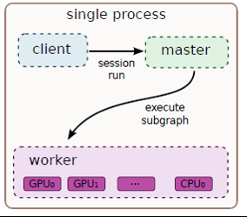
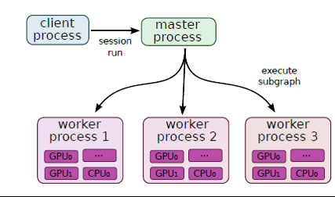
3. Implementation
There are three primary components in a TensorFlow system: the client, the master, and worker processes
The master schedules and coordinates worker processes and relays results back to the client.
The client uses a Session interface to communicate with the master.
Worker processes are responsible for maintaining access to devices such as CPU/GPU cores and execute graph nodes on their respective devices.

Slide 10
Devices
Each device has both a device type and a name
Names are composed of the device's type, its index in a worker process, and (when used in a distributed setting) an identification of the job and task of the worker process
Example device names:
Local: /job:localhost/device:cpu:0
Distributed: /job:worker/task:17/device:gpu:3
A device object manages its device's memory and executes kernels as requested
Tensors
Typed, multi-dimensional array
Memory management of tensors is handled automatically

Slide 11
3.1. Single-Device Execution
All nodes required to compute the desired output node(s) are determined
Each node is given a count of dependencies that need to be completed before it can begin execution
When a node's dependency count is zero, it is added to a ready queue
The ready queue delegates node kernel execution to device objects
When a node completes execution, the counts of all dependant nodes are decremented
Repeat steps 3-5 until the desired output is computed

Slide 12
3.2. Multi-Device Execution
There are two main challenges introduced when using multiple devices:
Deciding which device should process each node
Managing communication between devices as necessary after assigning nodes
3.2.1. Node Placement
Cost model is created, containing estimated computation and communication time.
Every feasible (matching kernel) device for each node is identified and examined and the device finishing the operation sooner is selected ( Greedy Algorithm ) .

Slide 13
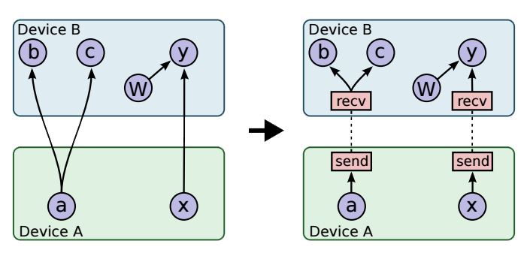
3.2.2. Cross-Device Communication
After performing node placement the graph is divided into a set of subgraphs.
Any edge between nodes on different devices is replaced by two new edges:
The outputing node will have an edge between it and a new Send node
The recieving node will have an edge between it and a new Receive node
Memory allocation
Synchronization
Scalability
Single run execution per graph

Slide 14
3.3. Distributed Execution
Similar to multi-device execution. Send/Receive nodes that communicate across worker processes use mechanisms such as TCP or RDMA ( remote direct memory access ) to transmit data from machine to machine
Fault Tolerance
Main failures are communication errors
When a failure is detected the operations are all aborted.
There are some mechanisms for checkpointing and recovery after a restart.

Slide 15
Outline
Abstract
Programming Model and Basic Concepts
Implementation
Extensions
Gradient Computation
Partial Execution
Device Constraints
Control Flow
Input Operations
Queues
Containers
Optimizations
Common Programming Idioms

Slide 16
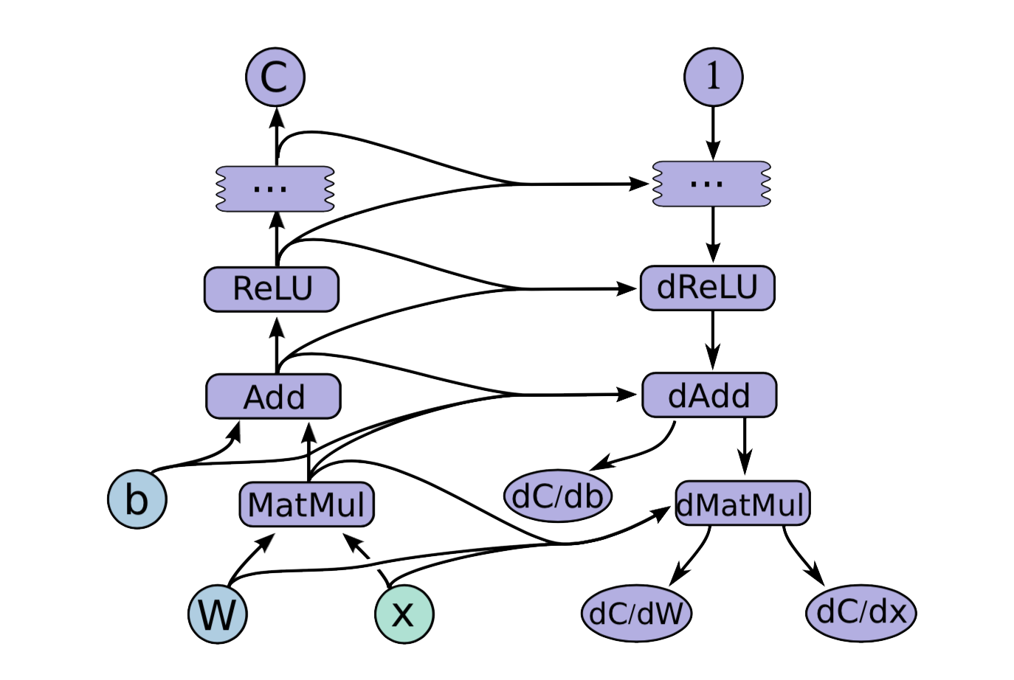
4.1. Gradient Computation
TensorFlow has built-in gradient computation
If a tensor, C, depends on a set of previous nodes, the gradient of C with respect to those previous nodes can be automatically computed with a built-in function, even if there are many layers in between them
Derivations are computed using the chain rule.
The area of improvement for automatic gradient computation is memory management.

Slide 17
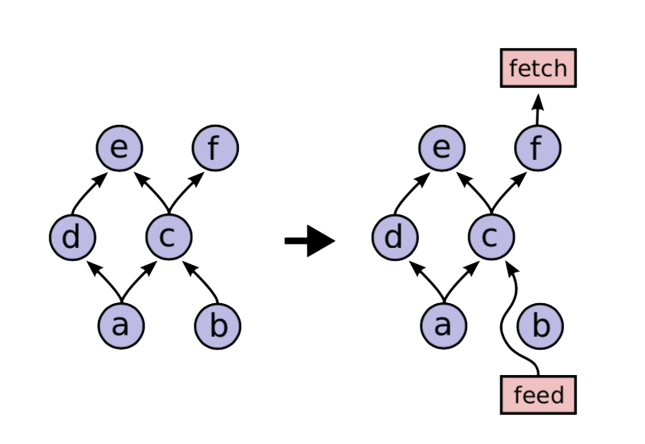
4.2. Partial Execution
Every tensor is defined using name : port
We specify the exact subgraph using fetch and feed arguments.
Once the fetch and feed nodes have been inserted, TensorFlow determines which nodes need to be executed. It moves backwards, starting at the fetch nodes, and uses the dependencies of the graph to determine all nodes that must be executed in the modified graph in order to compute the desired outputs

Slide 18
4.3. Device Constraints
Users can provide partial constraints on nodes about which devices they can run on
Examples: only allowing a node to run on GPUs, specifying a specific worker process/task, or ensuring that it is grouped with specific nodes
Then constraints are added to the node placement Algorithm (3.2.1) .
4.4. Control Flow
TensorFlow incorporates a few primitive control flow operators which allow for the skipping of subgraph execution and the expression of iteration. Using these primitive operators, higher-level constructs such as if and while statements can be compiled into TensorFlow graphs.
The Enter, Leave, and NextIteration operators allow us to express High-level programming blocks!

Slide 19
4.5. Input Operations
There is also the possibility to provide the input using files.
Using this feature can reduce data transfer overhead when using TensorFlow on a distributed implementation (specifically when the client is on a different machine from the worker process):
Using feed_dict will cause data to first be sent from the storage system to the client, and then from client to the worker process.
Reading from the file will cause data to be sent directly from the storage system to the worker process.
Ex : tf.TextLineReader
4.6. Queues
Queues allows us to prefetch next batch of data while the previous batch is being processed.
It supports FIFO and shuffling queue that can be useful for machine learning algorithms.

Slide 20
Outline
Abstract
Programming Model and Basic Concepts
Implementation
Extensions
Optimizations
Common Subexpression Elimination
Controlling Data Communication and Memory Usage
Lossy Compression
Common Programming Idioms

Slide 21
5.1. Common Subexpression Elimination
Before execution, TensorFlow does a pass over the computation graph and reduces nodes with identical inputs and operations down to a single node.
This prevents redundant execution of the same computation.

Slide 22
5.2. Controlling Data Communication and Memory Usage
Proper scheduling of operations can create dramatic improvements on data transfer and memory usage rates by reducing the amount of time intermediate data needs to be stored in memory
One particular example used in the implementation TensorFlow is the scheduling of Receive nodes (see "3.2 Cross Device Communication")
5.3. Lossy Compression
Converts 32-bit floating point representation to 16-bit representation and then converts it back to 32-bit and replaces the lost parts with zeros.

Slide 23
Outline
Abstract
Programming Model and Basic Concepts
Implementation
Extensions
Optimizations
Common Subexpression
Common Programming Idioms
Data Parallel Training
Model Parallel Training

Slide 24
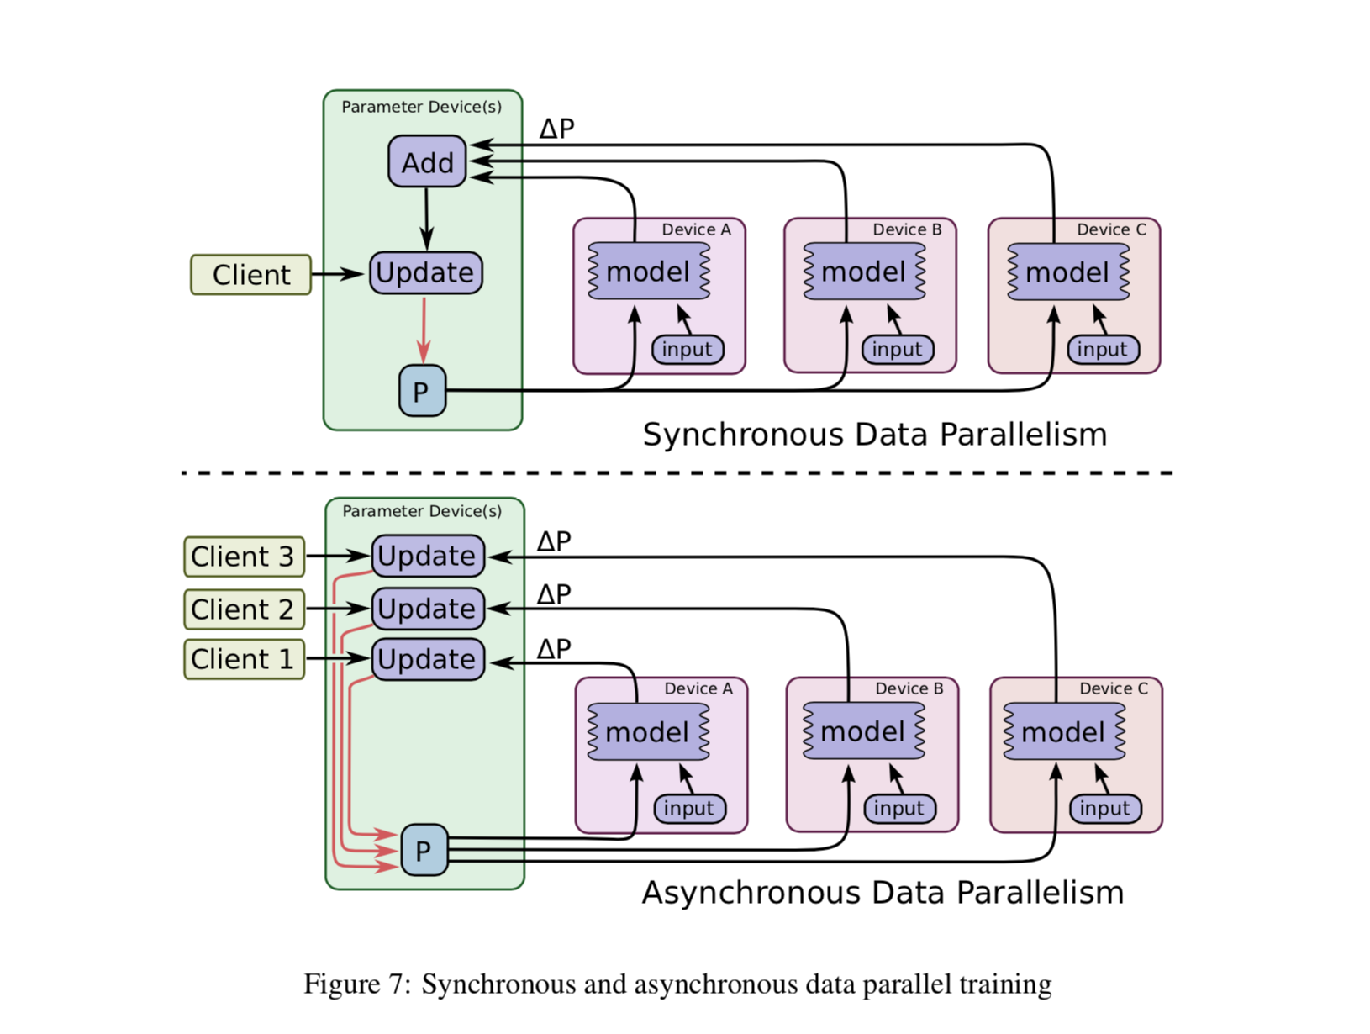
7.1. Data Parallel Training
Users can parallelize the computation of the gradient, separating mini-batch elements onto different devices
For example, a mini-batch size of 1000 elements can be split into 10 smaller, parallel computations of 100 elements. After they all finish running, their results can be combined to achieve the same result as if the entire calculation was performed in a single, sequential computation
Can be implemented both with 1 master or multiple masters

Slide 25
7.2. Model Parallel Training
Can run separate portions of the computation graph on different devices simultaneously on the same batch of examples
Can also run a small set of concurrent training steps on a single device
This can "fill in the gaps" of device utilization, when parallel execution on all devices might not make full use of computation cycles

Slide 26
Thanks for your attention

